Slide 1

Regular expression

Slide 2
INDEX
Introduction
String functions
Searching strings
Splitting and Joining strings
Regular expression
Classes and Special Sequence
Regex String-Manipulation functions
Grouping
Back references
Compiling regex pattern

Slide 3
REGULAR EXPRESSION
Provide more efficient and powerful alternative to string search methods
Text pattern that a program uses to find substrings that match patterns
Processing capabilities provided by module “re”.
There are few functions provided by “re” module to search the string.
Search() function used to search the pattern in the string anywhere, whereas match() function will search the pattern at start of the string.

Slide 4
REGULAR EXPRESSION
1 # Fig. 13.7: fig13_07.py
2 # Simple regular-expression example.
3
4 import re
5
6 # list of strings to search and expressions used to search
7 testStrings = [ "Hello World", "Hello world!", "hello world" ]
8 expressions = [ "hello", "Hello", "world!" ]
9
10 # search every expression in every string
11 for string in testStrings:
12
13 for expression in expressions:
14
15 if re.search( expression, string ):
16 print expression, "found in string", string
17 else:
18 print expression, "not found in string", string
19
20 print

Slide 5
REGULAR EXPRESSION
hello not found in string Hello World
Hello found in string Hello World
world! not found in string Hello World
hello not found in string Hello world!
Hello found in string Hello world!
world! found in string Hello world!
hello found in string hello world
Hello not found in string hello world
world! not found in string hello world

Slide 6
REGULAR EXPRESSION CHARACTERS
Patterns built using combination of meta characters and escape sequences
Meta character: regular-expression syntax element that repeats, groups, places or classifies one or more characters
  “.”: matches any character except a new line.
  ?: matches zero or one occurrences of the expression it follows
  +: matches one or more occurrences of the expression it follows
  *: matches zero or more occurrences of the expression it follows
  ^: indicates placement at the beginning of the string
  $: indicates placement at the end of the string
  \: matches special characters.
  |: matches any one.

Slide 7
1 # Fig. 13.9: fig13_09.py
2 # Repetition patterns, matching vs searching.
3
4 import re
5
6 testStrings = [ "Heo", "Helo", "Hellllo" ]
7 expressions = [ "Hel?o", "Hel+o", "Hel*o" ]
8
9 # match every expression with every string
10 for expression in expressions:
11
12 for string in testStrings:
13
14 if re.match( expression, string ):
15 print expression, "matches", string
16 else:
17 print expression, "does not match", string
18
19 print
20
21 # demonstrate the difference between matching and searching
22 expression1 = "elo" # plain string
23 expression2 = "^elo" # "elo" at beginning of string
24 expression3 = "elo$" # "elo" at end of string
25
26 # match expression1 with testStrings[ 1 ]
27 if re.match( expression1, testStrings[ 1 ] ):
28 print expression1, "matches", testStrings[ 1 ]
REGEX CHARACTERS
? matches 0 or 1 occurrences of l
* Returns zero or more occurrences of l
+ matches 1 or more occurrences of l

Slide 8
REGEX CHARACTERS
30 # search for expression1 in testStrings[ 1 ]
31 if re.search( expression1, testStrings[ 1 ] ):
32 print expression1, "found in", testStrings[ 1 ]
33
34 # search for expression2 in testStrings[ 1 ]
35 if re.search( expression2, testStrings[ 1 ] ):
36 print expression2, "found in", testStrings[ 1 ]
37
38 # search for expression3 in testStrings[ 1 ]
39 if re.search( expression3, testStrings[ 1 ] ):
40 print expression3, "found in", testStrings[ 1 ]

Slide 9
REGEX CHARACTERS
Hel?o matches Heo
Hel?o matches Helo
Hel?o does not match Hellllo
Hel+o does not match Heo
Hel+o matches Helo
Hel+o matches Hellllo
Hel*o matches Heo
Hel*o matches Helo
Hel*o matches Hellllo
elo found in Helo
elo$ found in Helo

Slide 10
REGEX QUANTIFIERS
Other quantifiers:
  {m} => Matches exactly m copies of the previous RE should be matched;
  {m,n} => Matches from m to n repetitions of the preceding RE
Example:
A {2} => Matches ‘A’ exactly 2 times.
A {2, } => Matches ‘A’ at least 2 times.
A { ,2} => Matches ‘A’ at maximum of 2 times.
A {2, 6} => Matches ‘A’ minimum of 2 and maximum of 6

Slide 11
CLASSES AND SPECIAL SEQUENCE
Regular-expression building blocks
Character class: specifies a group of characters to match in a string
  Denoted by []
  Metacharacter ^ at beginning negates character class
Special sequence: shortcut for a common character class

Slide 12
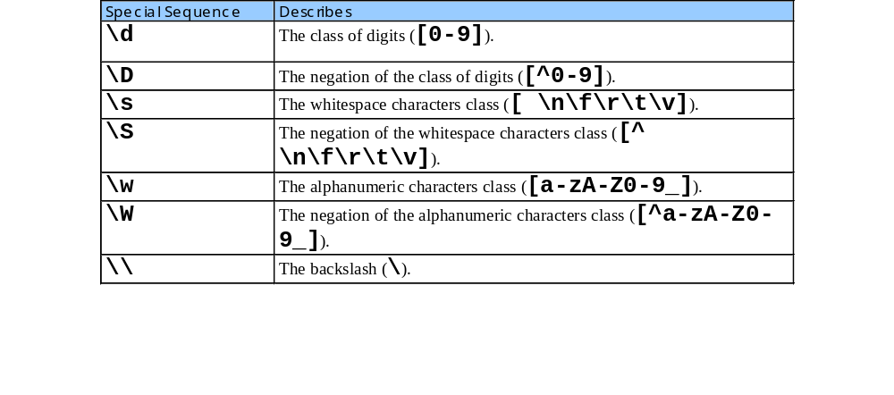
CLASSES AND SPECIAL SEQUENCE

Slide 13
CLASSES AND SPECIAL SEQUENCE
1
2 # Program that demonstrates classes and special sequences.
3 import re
4
5 # specifying character classes with [ ]
6 testStrings = [ "2x+5y","7y-3z" ]
7 expressions = [ r"2x\+5y|7y-3z",
8 r"[0-9][a-zA-Z0-9_].[0-9][yz]",
9 r"\d\w-\d\w" ]
10
11 # match every expression with every string
12 for expression in expressions:
13 for testString in testStrings:
14 if re.match( expression, testString ):
15 print expression, "matches", testString
16
17 # specifying character classes with special sequences
18 testString1 = "800-123-4567"
19 testString2 = "617-123-4567"
20 testString3 = "email: \t joe_doe@deitel.com"
21
22 expression1 = r"^\d{3}-\d{3}-\d{4}$"
23 expression2 = r"\w+:\s+\w+@\w+\.(com|org|net)"
24
25 # matching with character classes
26 if re.match( expression1, testString1 ):
27 print expression1, "matches", testString1
28

Slide 14
CLASSES AND SPECIAL SEQUENCE
2x\+5y|7y-3z matches 2x+5y
2x\+5y|7y-3z matches 7y-3z
[0-9][a-zA-Z0-9_].[0-9][yz] matches 2x+5y
[0-9][a-zA-Z0-9_].[0-9][yz] matches 7y-3z
\d\w-\d\w matches 7y-3z
^\d{3}-\d{3}-\d{4}$ matches 800-123-4567
^\d{3}-\d{3}-\d{4}$ matches 617-123-4567
\w+:\s+\w+@\w+\.(com|org|net) matches email: joe_doe@deitel.com

Slide 15
STRING MANIPULATION FUNCTIONS
Module re provides pattern-based, string-manipulation capabilities, such as substituting a substring in a string and splitting a string with a delimiter
1 # Regular-expression string manipulation.
2
import re
text = “welcome to regular expression”
string = re.split(“ “,text)
print string
[‘welcome’,’to’,’regular’,’expression’]

Slide 16
GROUPING
Regular expression may specify groups of substrings to match in a string
Program extracts information from matching groups
Meta characters ( and ) denote a group
Greedy operators (+ and *) attempt to match as many characters as possible even if this is not the desired behavior
The contents of a group can be retrieved after a match has been performed, and can be matched later in the string with the \number special sequence.

Slide 17
GROUPING
1 # Fig. 13.14: fig13_14.py
2 # Program that demonstrates grouping and greedy operations.
3
4 import re
5
6 formatString1 = "%-22s: %s" # string to format output
7
8 # string that contains fields and expression to extract fields
9 testString1 = \
10 "Albert Antstein, phone: 123-4567, e-mail: albert@bug2bug.com"
11 expression1 = \
12 r"(\w+ \w+), phone: (\d{3}-\d{4}), e-mail: (\w+@\w+\.\w{3})"
13
14 print formatString1 % ( "Extract all user data",
15 re.match( expression1, testString1 ).groups() )
16 print formatString1 % ( "Extract user e-mail",
17 re.match( expression1, testString1 ).group( 3 ) )
18 print
19
20 # greedy operations and grouping
21 formatString2 = "%-38s: %s" # string to format output
22
23 # strings and patterns to find base directory in a path
24 pathString = "/books/2001/python" # file path string
25

Slide 18
GROUPING
26 expression2 = "(/.+)/" # greedy operator expression
27 print formatString1 % ( "Greedy error",
28 re.match( expression2, pathString ).group( 1 ) )
29
30 expression3 = "(/.+?)/" # non-greedy operator expression
31 print formatString1 % ( "No error, base only",
32 re.match( expression3, pathString ).group( 1 ) )
Extract all user data : ('Albert Antstein', '123-4567', 'albert@
bug2bug.com')
Extract user e-mail : albert@bug2bug.com
Greedy error : /books/2001
No error, base only : /books

Slide 19
COMPILING REGEX PATTERN
Compiled regular expressions represented by SRE_Pattern object, which provides all functionality available in module re
If a program uses a regular expression several times, the compiled version may be more efficient
Methods re.search and re.match return an SRE_Match object

